Slide 1
Containerization

Slide 2
Contents
Containers
Containers tools
Docker
Features of Docker
Docker Architecture
Docker Management

Slide 3
Containers
Containers are packages of software that contain all of the necessary elements to run in any environment.
Containers provide a standard method of packaging an application's code, runtime, system tools, system libraries, and configurations into one instance.
Containers share one kernel (operating system), which is installed on the hardware.

Slide 4
Containers Tools
Docker
Kubernetes
And many more

Slide 5
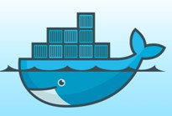
What is Docker?
Docker is a software platform that allows you to build, test, and deploy applications quickly, packaging software into standardized units called containers.

Slide 6
Features of Docker
Docker has the ability to reduce the size of development by providing a smaller footprint of the operating system via containers.
With containers, it becomes easier for teams across different units, such as development, QA and Operations to work seamlessly across applications.
You can deploy Docker containers anywhere, on any physical and virtual machines and even on the cloud.
Since Docker containers are pretty lightweight, they are very easily scalable.

Slide 7
Features of Docker (Cont.)
Easy and Faster Configuration: Deploy the code in less time and efforts.
Increase productivity: It has increase productivity.
Application Isolation: It is used to run applications in isolation environment. Each container is independent to another and allows us to execute any kind of application.

Slide 8
Install Docker on Windows
Docker install on any operating system i.e. Windows, Linux, or Mac.
https://www.docker.com/products/docker-desktop

Slide 9
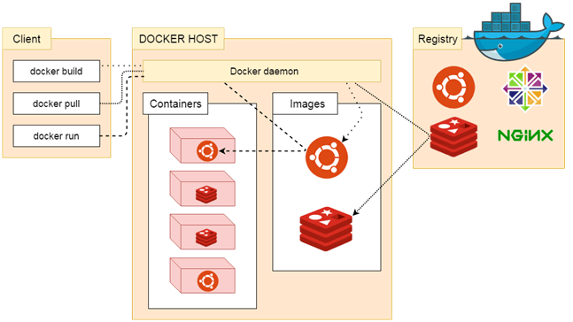
Docker Architecture

Slide 10
Docker Architecture (Cont.)
Docker follows Client-Server architecture.
There are three main components that are:
Docker Client
Docker Host
Docker Registry.

Slide 11
Docker Architecture (Cont.)
Docker Client
Docker client uses commands to communicate with the Docker Daemon (Server).
When a client runs any docker command on the docker client terminal, the client terminal sends these docker commands to the Docker daemon. Docker daemon receives these commands from the docker client in the form of command
Some docker Commands
docker build
docker pull
docker run

Slide 12
Docker Architecture (Cont.)
Docker Registry.
It is responsible to manages and stores the Docker images.
Provide repositories facilities on Docker hub (https://hub.docker.com/ ).
There are two types of registries
Pubic Registry
Private Registry - It is used to share images within the enterprise.

Slide 13
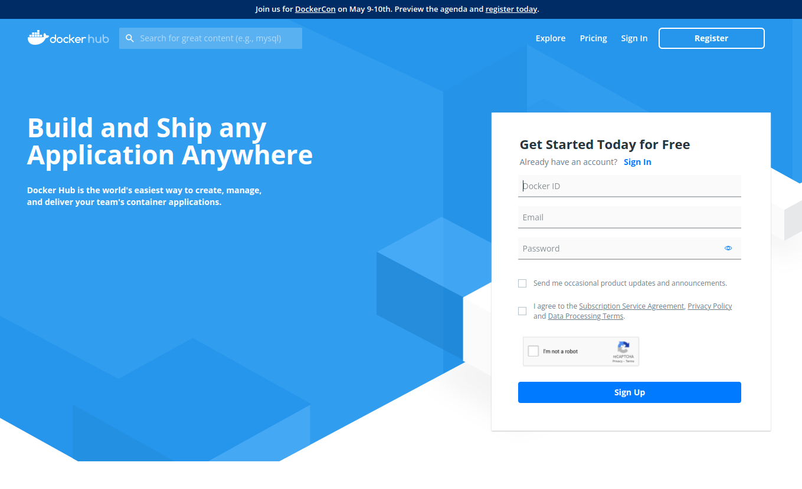
Public Container Registry
https://hub.docker.com
Create your ID and Sign Up

Slide 14
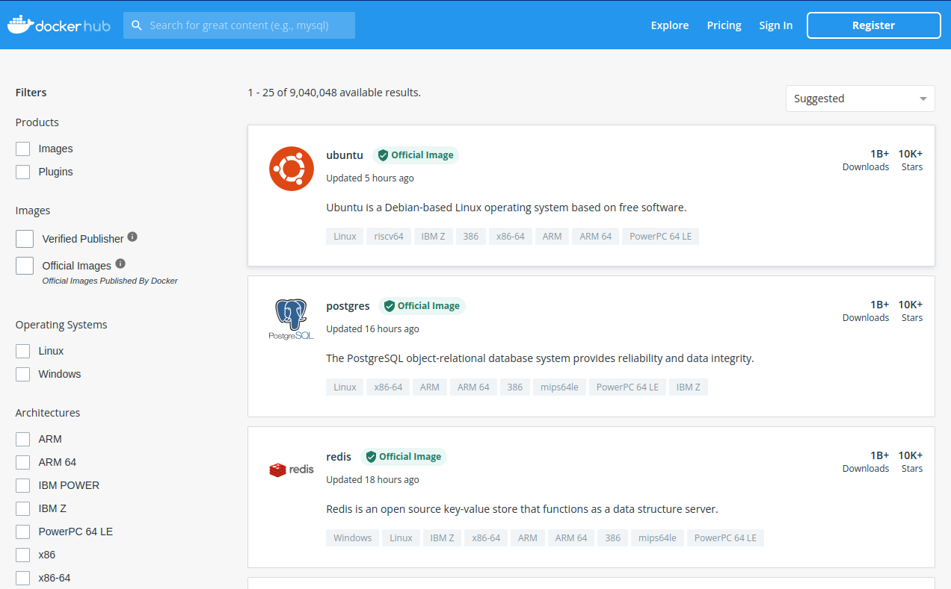
Public Container Registry
https://hub.docker.com
Explore Images
Verified Publisher (High quality Docker content from verified publisher)
Official Images (Published By Docker)

Slide 15
Docker Architecture (Cont.)
Docker Host
This component is used to provide an environment to execute and run applications. It contains the docker daemon, images, containers, networks, and storage.

Slide 16
What is Docker Daemon?
The Docker daemon is a service that runs on your host operating system.
Also known as Server
It is responsible for running containers to manage Docker services and communicates with other daemons.
It offers various Docker objects such as images, containers, networking, and storage.

Slide 17
Docker Host Objects
Docker Images
A Docker Image is a read-only file with a bunch of instructions. When these instructions are executed, it creates a Docker container.
It use to describe about the container registry are public or private.
A Docker image is described in text file called a Dockerfile, which has a simple, well-defined syntax.
Docker Dockerfile
It is a text document that contains commands that are used to assemble an image. We can use any command that call on the command line. Docker builds images automatically by reading the instructions from the Dockerfile.
docker build -t ImageName:TagName dir
docker build -t comsatsimage

Slide 18
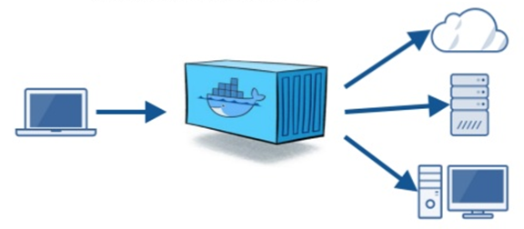
Dockerfile
Docker File, consists of many read-only layers.
Each layer is an instruction
Each layer is a delta of the changes from the previous layer
Docker builds images automatically by reading the instructions from a dockerfile

Slide 19
Dockerfile Commands
FROM
The base image for building a new image Should be first line.
MAINTAINER
Optional, it contains the name of the maintainer of the image.
RUN
execute a command during the build process of the docker image.
ADD
Copy a file from the host machine to the new docker image. Can download
from URL also
ENV
Define environment variable
CMD
Executing commands in the container
USER
Set the user or UID for the container
VOLUME
Enable access/linked directory between the container and the host machine
EXPOSE
Expose ports

Slide 20
Dockerfile create, build, run & push
mkdir ~/mydockerimages cd ~/mydockerimages touch dockerfile
echo ‘print(“Hello World !!!”)’ >> test.py
From ubuntu:latest \
&& RUN sudo apt-get update \
&& sudo apt-get install python3 \
&& COPY test.py ~/test.py \
&& cd ~ \
&& CMD python3 test.py
docker build –f dockerfile –t myfirstdocker:v1.0
docker images
docker run myfirstdocker -it -–name mycontainer
docker login
docker push <username>/myfirstdocker:v1.0

Slide 21
Docker Volume
To save (persist) data and also to share data between containers.
Volumes are directories (or files) that are outside of the containers and exist as
normal directories and files on the host filesystem.
From docker file:
FROM ubuntu:latest \
VOLUME /data
Docker volume create command:
docker volume create --name my-vol \
Which can be attached to the container at runtime
docker run -d -v my-vol:/data mydocker

Slide 22
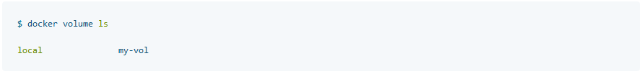
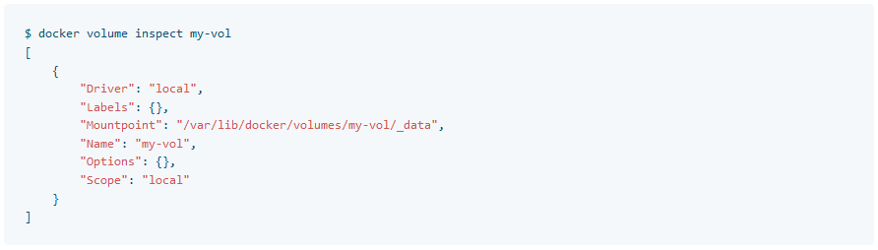
Docker Volume cont…

Slide 23
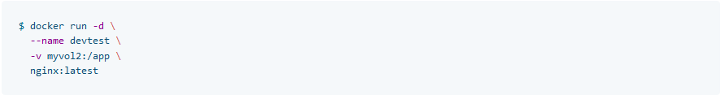
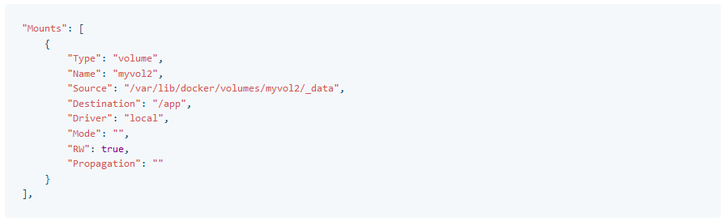
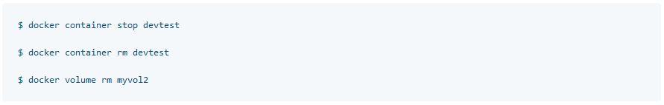
Starting/Stopping Container with Volume

Slide 24
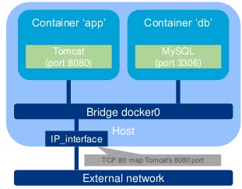
Publish Ports
Docker doesn’t publish any ports to outside world by default
-p or –publish flags are used to bind container ports to host
docker run -p 8080:80 –name mycon -it
Maps TCP port 80 in container
to 8080 on docker host, name it mycon and
run the container in interactive mode.

Slide 25
Docker Compose Install
Download Docker Compose
Apply executable permissions to the binary:
Verify Installation
curl -L "https://github.com/docker/compose/releases/download/1.25.5/docker-compose-$(uname -s)-$(uname -m)" -o /usr/local/bin/docker-compose
chmod +x /usr/local/bin/docker-compose
docker-compose --version

Slide 26
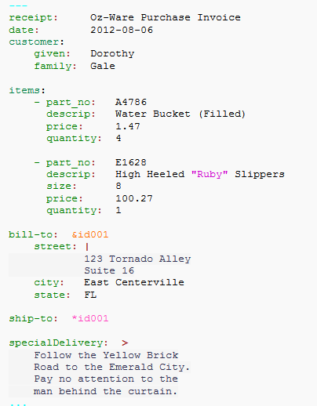
YAML
YAML stands for YAML ain’t markup language.
YAML is a human-readable data-serialization language.
Commonly used for configuration files and in applications where data is being stored or transmitted

Slide 27
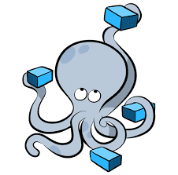
Docker Compose
Docker Compose is a tool for defining and running multi-container Docker applications
You use a YAML file to configure your application’s services.
With Docker Compose, we can create and stop complete environments with single commands:
Docker Compose Up
Docker Compose Down

Slide 28
Docker Compose Example
version: "3.9"
services:
db:
image: mysql:5.7
volumes:
- db_data:/var/lib/mysql
restart: always
environment:
MYSQL_ROOT_PASSWORD: somewordpress
MYSQL_DATABASE: wordpress
MYSQL_USER: wordpress
MYSQL_PASSWORD: wordpress
wordpress:
depends_on:
- db
image: wordpress:latest
volumes:
- wordpress_data:/var/www/html
ports:
- "8000:80"
restart: always
environment:
WORDPRESS_DB_HOST: db
WORDPRESS_DB_USER: wordpress
WORDPRESS_DB_PASSWORD: wordpress
WORDPRESS_DB_NAME: wordpress
volumes:
db_data: {}
wordpress_data: {}
Create dir my_wordpress
Cd in to dir and create file docker-compose.yml with contents show on right hand side.
Execute docker-compose up -d

Slide 29
Docker Management
Managing the states of the Docker containers is called Docker Container Lifecycle Management.
For managing the Docker Lifecycle we have some common commands.

Slide 30
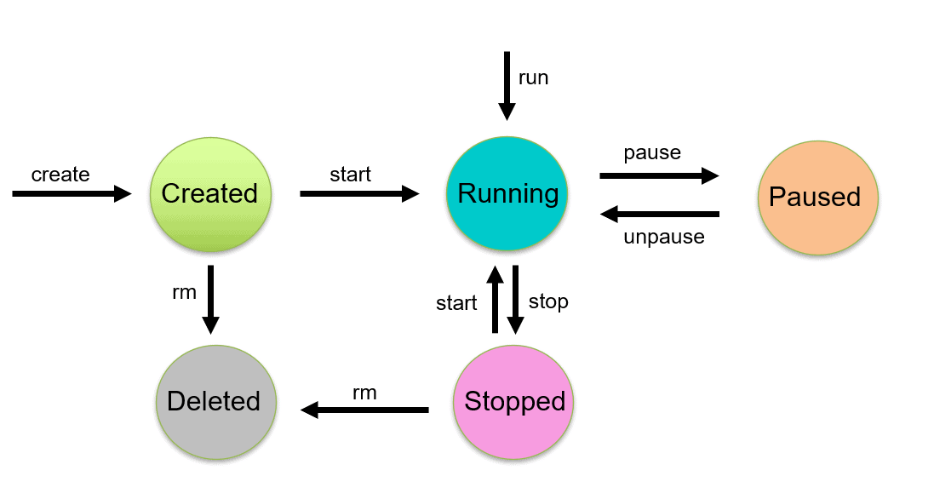
Docker Container Lifecycle Management Architecture.
Diagram

Slide 31
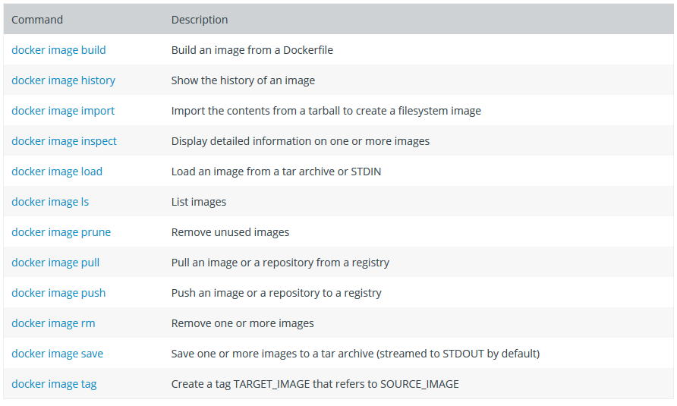
Docker Image Commands

Slide 32
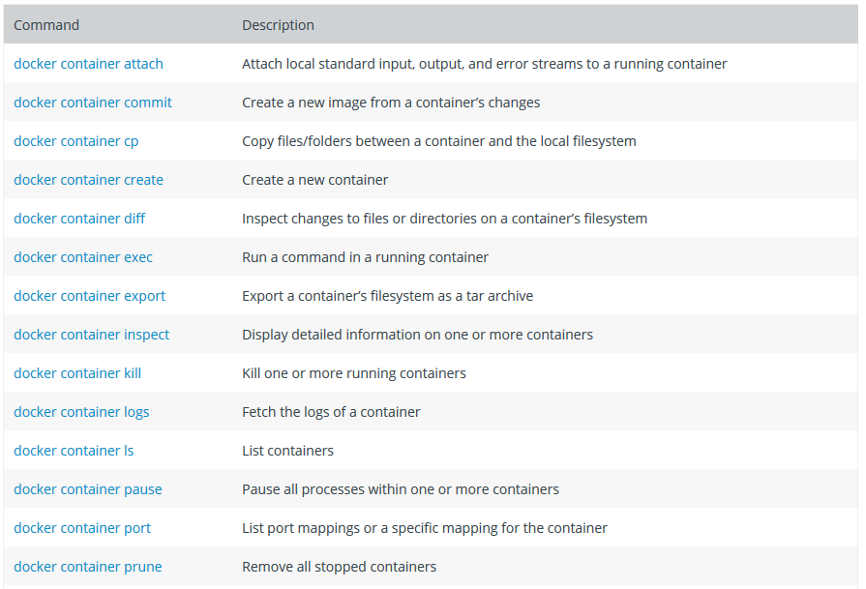
Docker Container Commands

Slide 33
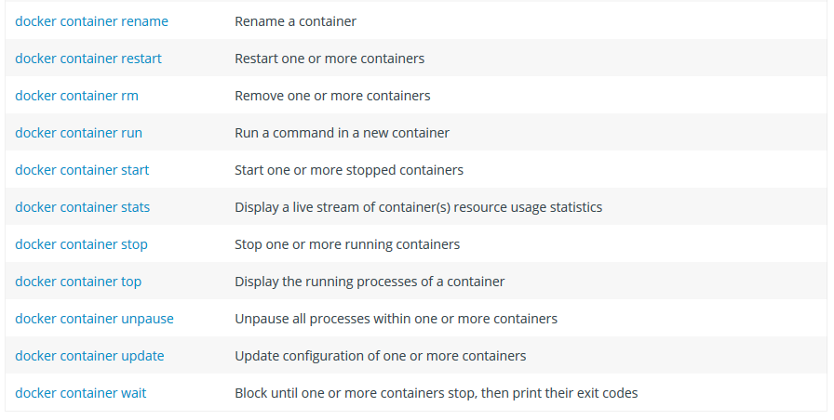
Docker Container Commands cont…

Slide 34
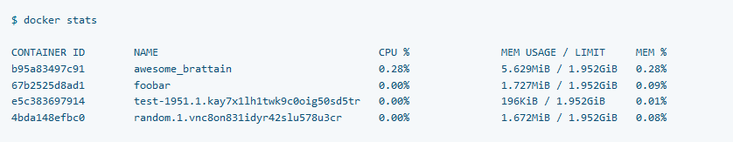
Docker Container Commands cont…
docker ps or docker container ls
Show all containers
Docker container ls -a
docker stats
Returns a live stream for running containers

Slide 35
Docker Management Commands
Create Containers
Using this will create a new Docker container with the specified Docker image
$ docker create --name <container name> <image name>
$ docker create --name c1 ubantu

Slide 36
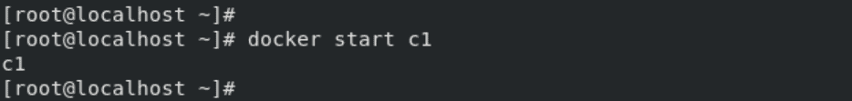
Docker Management Commands (Cont.)
Start Container
To start a stopped container, we can use the docker start command.
docker start <container name>

Slide 37
Docker Management Commands (Cont.)
Run Container
The docker run command will do the work of both “docker create” and “docker start” command.
This command will create a new container and run the image in the newly created container.
$ docker run -it --name <container name> <image name>

Slide 38
Docker Management Commands (Cont.)
Pause Container
If we want to pause the processes running inside the container, we can use the “docker pause” command.
$ docker pause <container name>

Slide 39
Docker Management Commands (Cont.)
Stop Container
Stopping a running Container means to stop all the processes running in that Container. Stopping does not mean killing or ending the process.
$ docker stop <container name>

Slide 40
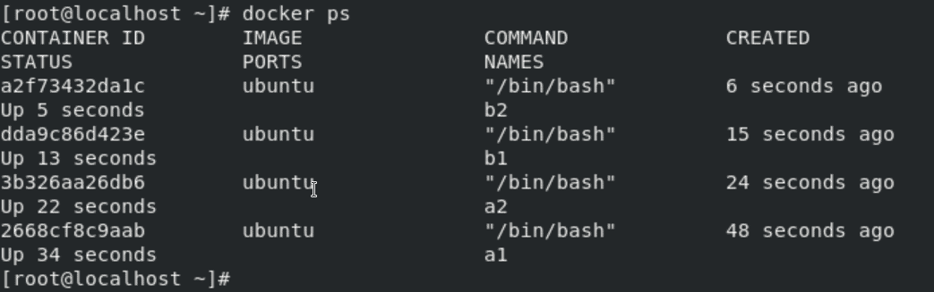

Docker Management Commands (Cont.)
Stop Container
We can stop all the containers using a single command. In our case, 4 containers are running which you can see using the docker ps command.

Slide 41
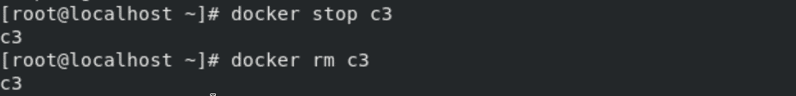
Docker Management Commands (Cont.)
Delete Container
Removing or deleting the container means destroying all the processes running inside the container and then deleting the Container.
It’s preferred to destroy the container, only if present in the stopped state instead of forcefully destroying the running container.
$ docker rm <container name>

Slide 42
Thanks
…?

